Slide 1

GUIDANCE

Slide 2
TEAM ARRANGEMENT
Recommendations:
Teams should try to be a max of 6 people.
Try to ensure a diversity of skills.
Be aware of what people want from the event.
Rules:
Multiple teams can tackle the same challenge.
You must submit your Team information by 11:00 am Day 1, including a designated Team Captain.
Teams are free to work through the night.
Think about the following skills:
Data Science
Development
Data Analyst
Data Visualisations
Project Management
Project Controls

Slide 3

THE DEVELOPMENT PROCESS
Requirements Gathering
Product Vision
User Story
Concept
Design
Value

Slide 4
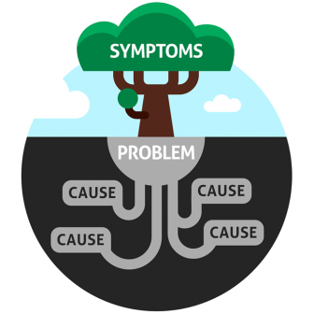
REQUIREMENTS GATHERING
A Hack is about exploring The Art of the Possible and trying to find innovative solutions to real world problems.
Always start by analysing the problem and finding the Root Cause.
Solve the Problem not the Symptoms.

Slide 5

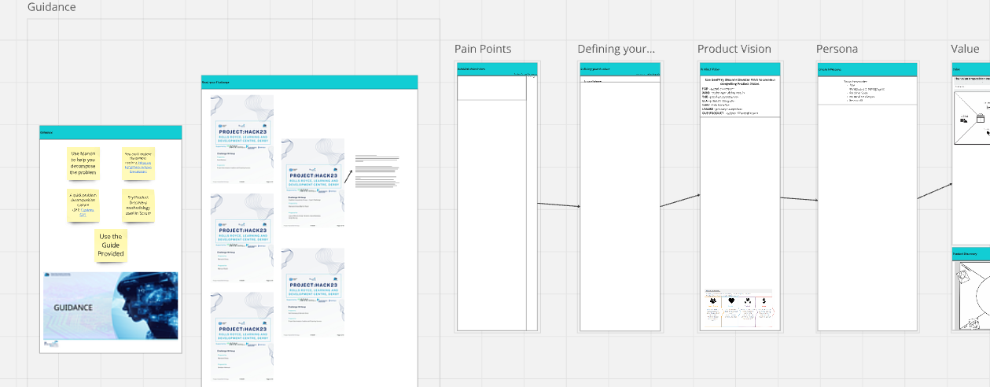
PLANNING TOOL
Use Miro to perform your Product Discovery

Slide 6

PLANNING TOOL
We have provided you with access to a Miro board to help you decompose your problem.
Teams can find their board linked in the Microsoft Teams Rooms(I.e. Team 1A, Team 1B….etc)
This not only makes it easier to work together and design your solution, it also allows us to understand and learn from your achievements.
The Judges will also consider this when reviewing your results

Slide 7
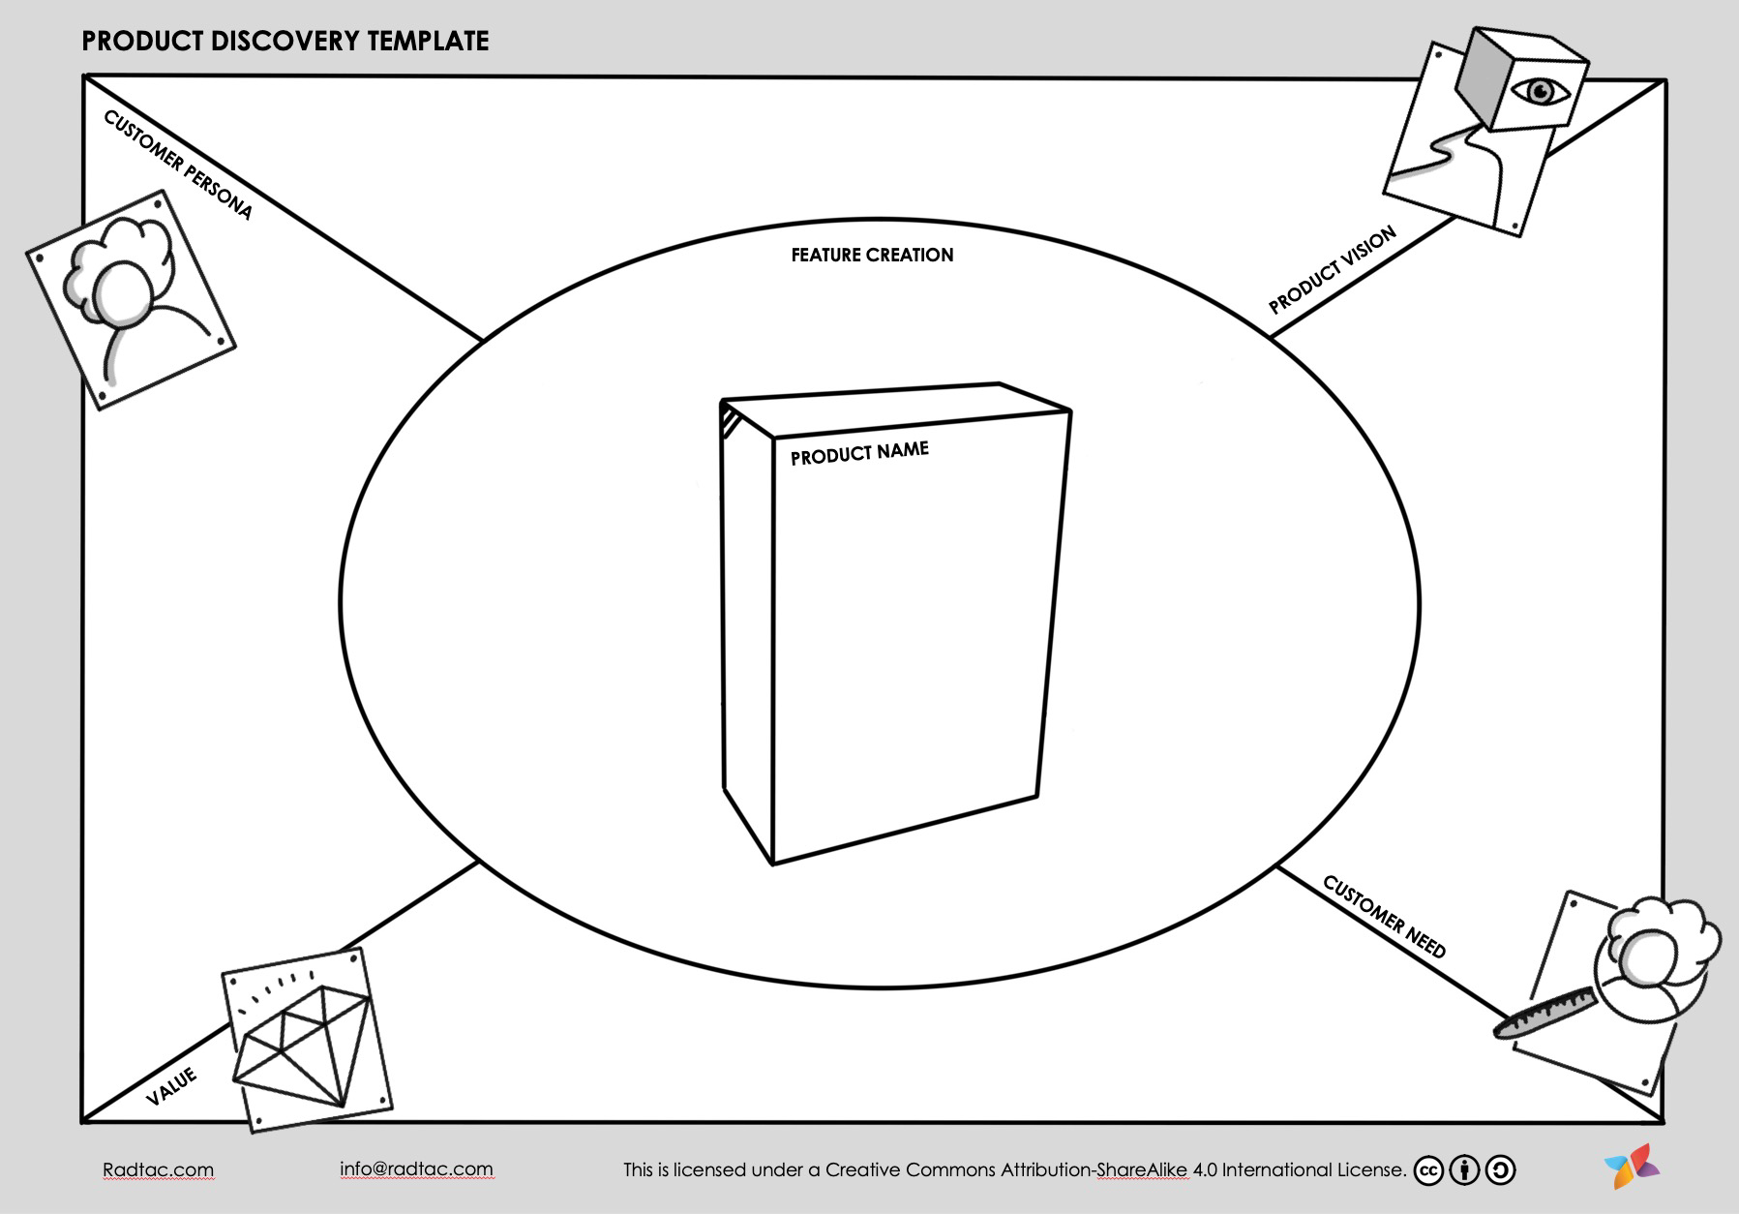
PRODUCT DISCOVERY
Customer Need
Product Vision
Customer Persona
Value
Creating Features

Slide 8
Talk to your Challenge Owner, they are here as the client and can answer any questions you may have about the problem.
Use your Pain Points as some core needs to focus on.
Begin thinking about what sort of tools will best fit the problem, what software you will use to create the solution.
CUSTOMER NEED

Slide 9
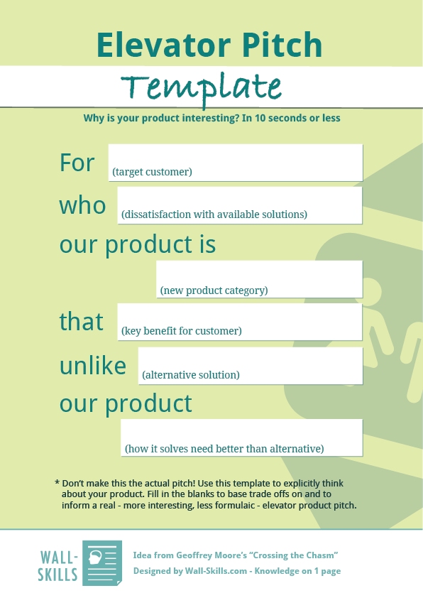
PRODUCT VISION
What will your solution look like? What will it be called?
What would a solution need to be able to do in order to fulfil the core need?
A good way to do this is to create an Elevator Pitch for your idea.
Envision what comes next, what would your solution look like if you had a week to make it, what would it look like if you had a month, a year?
Make sure you include your Vision in your final presentation.

Slide 10
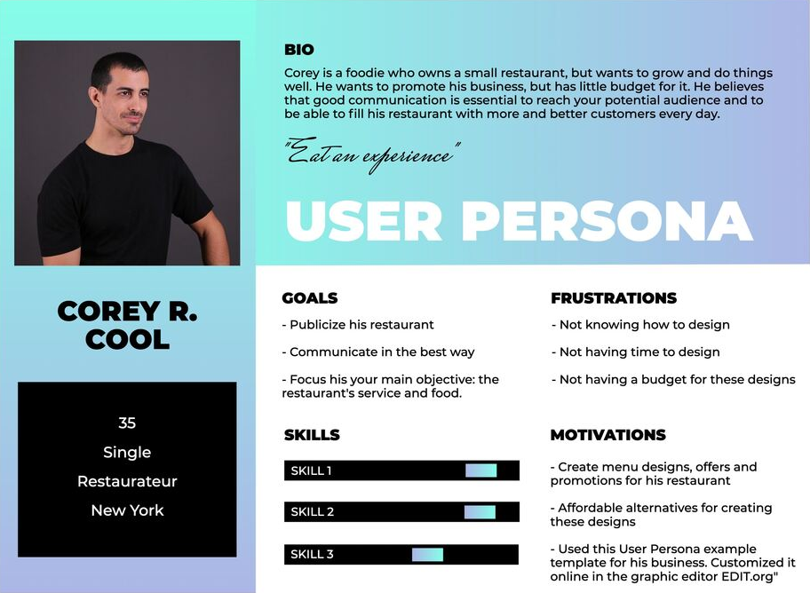
USER PERSONA
Use the User Persona to inform you on the types of users you have.
Think about the different users:
Background & demographic
Personal goals
Personal challenges
Product fit

Slide 11

VALUE
What value will your solution bring?
Will it save time?
Will it improve quality?
Will it change work culture?
Is it worth investing in?
What does the effort vs value look like?

Slide 12
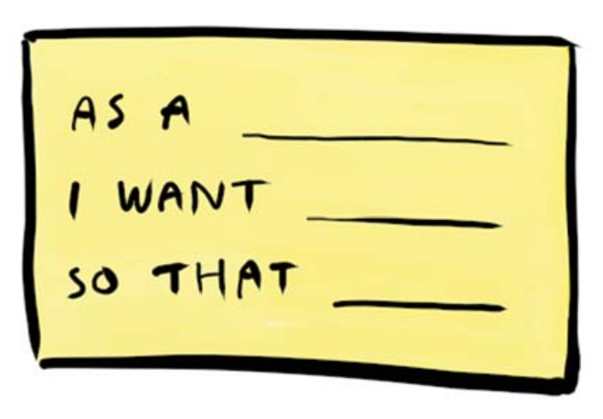
CREATING FEATURES
Design a solution on a feature by feature basis. What does your product specifically need to do?
How does a feature fulfil a customer need?
How does each feature drive the product vision?
Which user needs which feature and why?
How does each feature bring value?

Slide 13

PRIORITIES
What features are
the most important?
What is your
Minimum Viable Product
(MVP)?
What is possible
in two days?
Make sure you include your Product Discovery in your final presentation.
This will allow you to show the Judges why your solution is so great!

Slide 14

MODULARITY
Project:Hack is all about creating open-source benefits for the community.
As such, solutions designed to be reusable and interoperable with other industry tools are greatly valued by the Judges.

